Slide 1
CSE431: Natural Language Processing
Visual Dialog
Authors: Abhishek Das , Satwik Kottur , Khushi Gupta, Avi Singh, Deshraj Yadav, José M.F. Moura, Devi Parikh, Dhruv Batra
Submitted by Group 19
Rubayet Mahjabin (ID:20101011)
Nishat Zerin (ID: 20101136)
Sameer Sadman Chowdhury (ID: 21101105)

Slide 2
Introduction
What is Visual Dialog?
What the paper quantifies?

Slide 3
Abstract
What the paper proposed?
What they developed?
Related Papers
Paper: Visual Dialogue without Vision or Dialogue
Author Names: Daniela Massiceti Puneet K. Dokania N. Siddharth Philip H.S. Torr
Purpose: Eliminate the shortcomings
Result: The results are indicative of issues in current approaches to Visual Dialogue and conduct analyses to highlight implicit dataset biases and effects of over-constrained evaluation metrics
Paper: History for Visual Dialog: Do we really need it?
Author Names: Shubham Agarwal , Trung Bui , Joon-Young Lee , Ioannis Konstas and Verena Rieser
Purpose: Exposed the shortcomings and also showed co - attention models
Result: Provide a benchmark of 63% NDCG.

Slide 4
Dataset and Preprocessing
123K images from COCO-train/val
80K split for training, 3K for validation and 40K for testing
Using the Visual Dialog Dataset (VisDial)
For good data they used live chat interface
Building 2 person chat on AMT

Slide 5
Live Chat Interface
For this 2 workers were paired on AMT to chat with each other in real time.
Each worker was assigned a specific role. One worker (Questioner) can only see a single line of text describing an image which remains hidden to the worker. Their job is to ask questions to imagine the scene better. The other worker, who has access to the image, answers the questions accordingly.
The workers are allowed to end the conversation after 20 messages (10 pairs of questions and answers)

Slide 6
Building 2 person chat on AMT
Since AMT is not designed for multi-user Human Intelligence Tasks (HIT), hosting a live 2 person chat required the development of certain tools because Amazon didn’t have the appropriate ones for the task.
The authors developed their own backend messaging and data storage infrastructure using Redis messaging queues and Node.js.

Slide 7
Model Distinction
Neural Visual Dialog Models
2 decoders used:
Generative Long Short Term Memory decoder
Discriminative softmax decoder
3 encoders used: Late Fusion Encoder
Hierarchical Recurrent Encoder
Memory Network Encoder

Slide 8
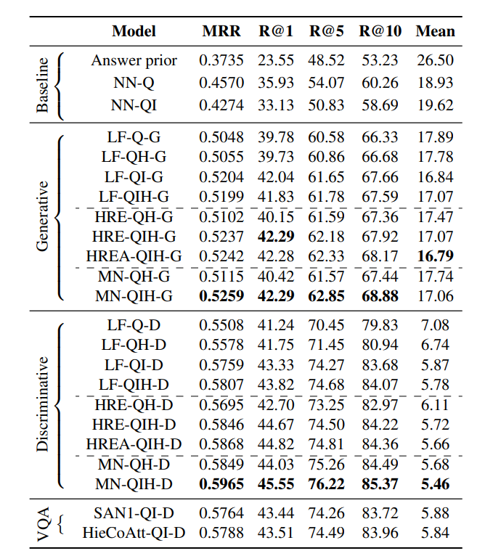
Result Analysis
The two best models:
MN-QIH-G -> 0.526 mean reciprocal rank,
&
MN-QIH-D -> 0.597 mean reciprocal rank

Slide 9
Conclusion
MN-QIH-D is the best model
Try this experiment with a bigger dataset and more question answer sessions

